Slide 1
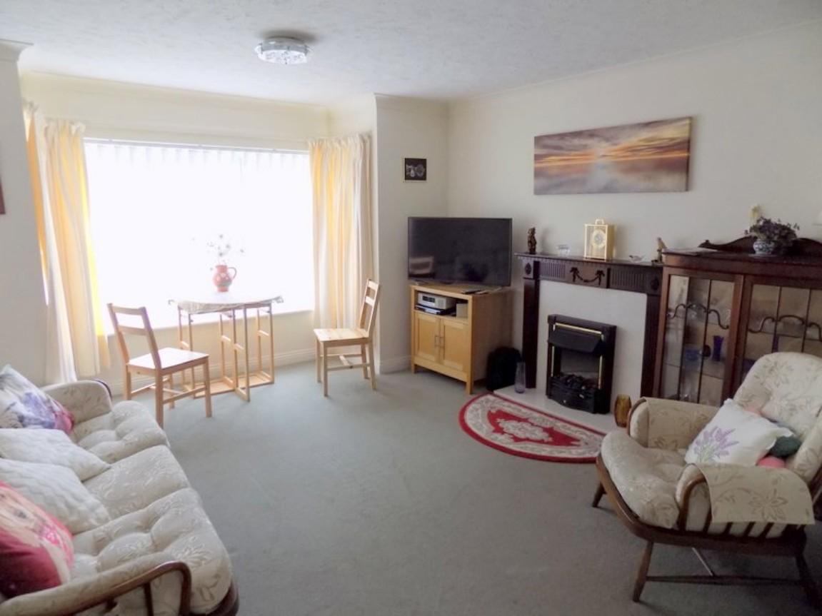
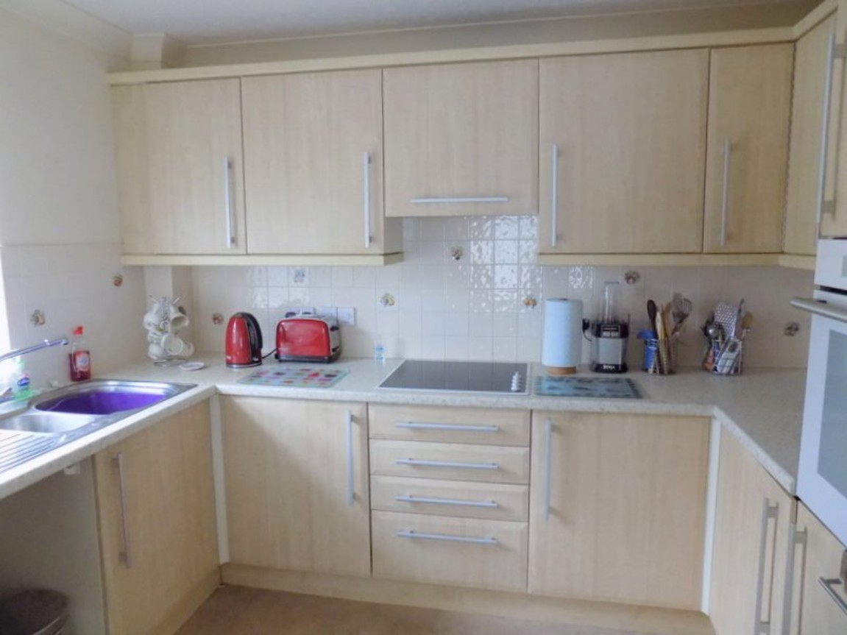
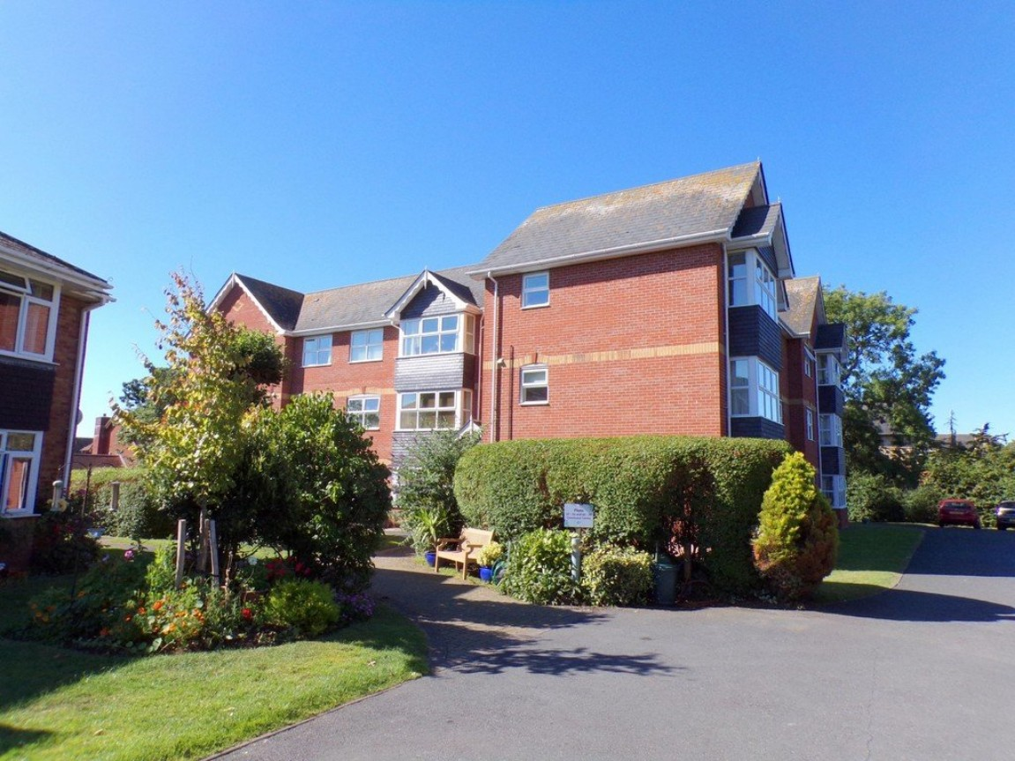
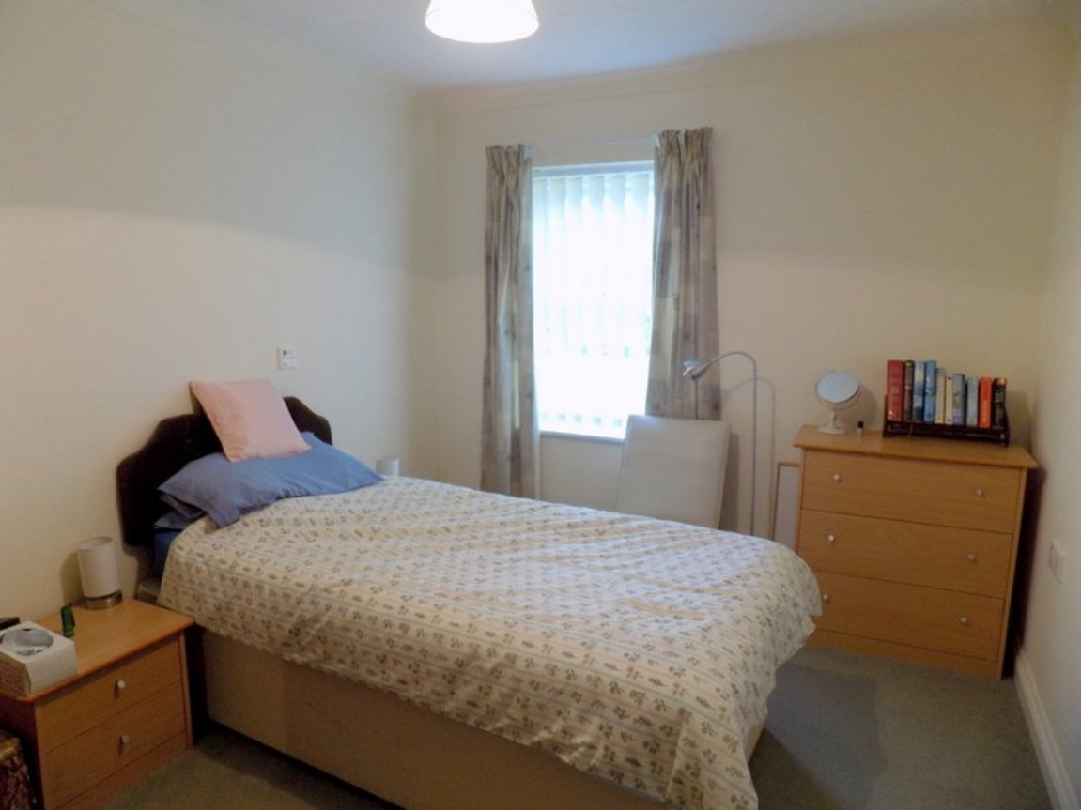
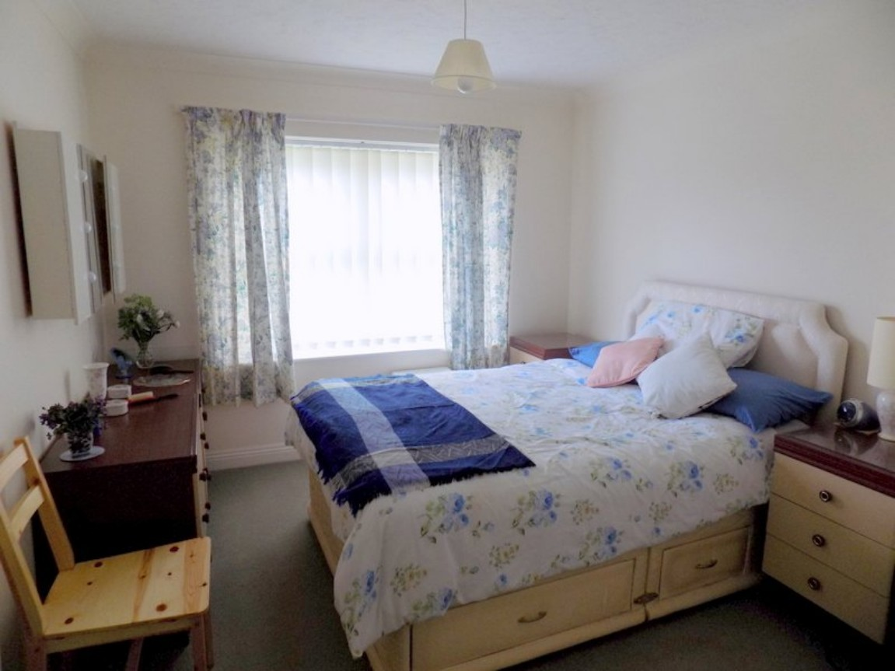
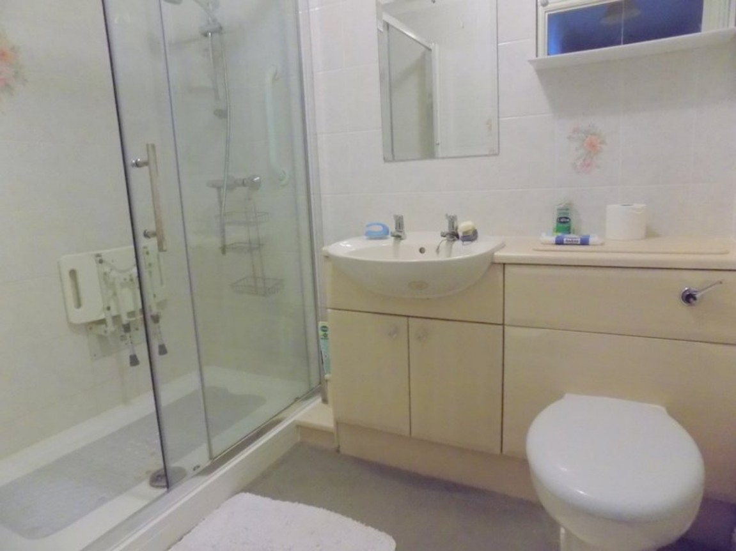
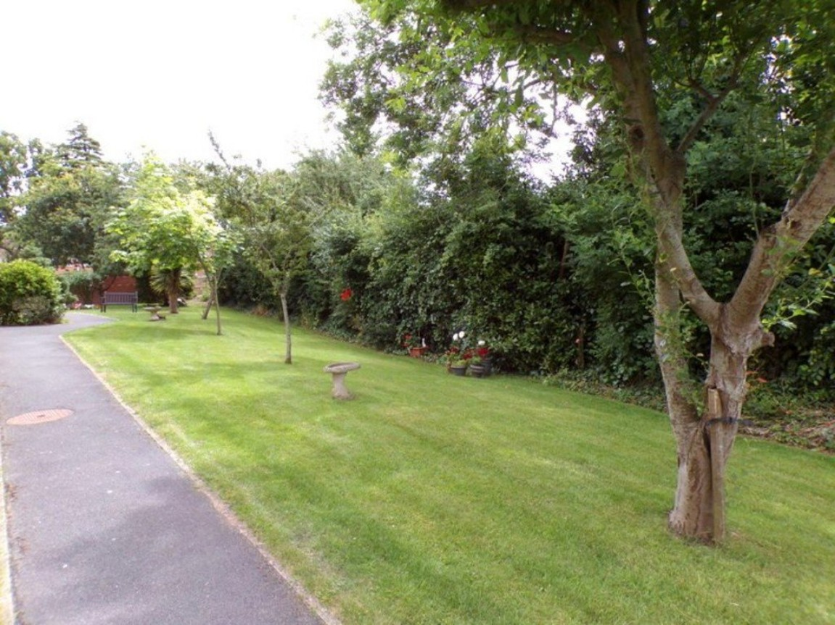
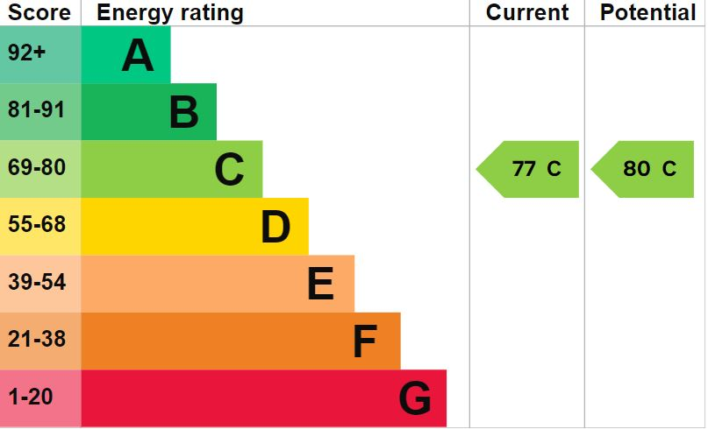
www.pennys.net
23 Exmouth Court, Long Causeway, Exmouth, Devon, EX8 1TB
PRICE £169,950
TENURE Leasehold
A Well Presented Two Bedroom Ground Floor Retirement Apartment Situated
In A Popular Development Close to Exmouth Hospital & Town Centre
Reception Hall With Built-In Cupboards • Spacious Lounge/Dining Room With Square Bay Window • Fitted Kitchen With Integrated Appliances • Two Double Bedrooms –
Main Bedroom With Built-in Double Wardrobe • Stylish Modern Shower Room/WC •
Electric Heating • Double Glazed Windows •
Excellent Communal Facilities Including Residents Lounge & Laundry Room •
Communal Gardens & Residents Parking Area • NO ONWARD CHAIN •
Pennys Estate Agents Limited for themselves and for the vendor of this property whose agents they are give notice that:- (1) These particulars do not constitute any part of an offer or a contract. (2) All statements contained in these particulars are made without responsibility on the part of Pennys Estate Agents Limited. (3) None of the statements contained in these particulars are to be relied upon as a statement or representation of fact. (4) Any intending purchaser must satisfy himself/herself by inspection or otherwise as to the correctness of each of the statements contained in these particulars. (5) The vendor does not make or give and neither do Pennys Estate Agents Limited nor any person in their employment has any authority to make or give any representation or warranty whatever in relation to this property.
PENNYS ESTATE AGENTS
2 Rolle House, Rolle Street, Exmouth, Devon, EX8 2SN
Tel: 01395 264111 EMail: help@pennys.net

Slide 2
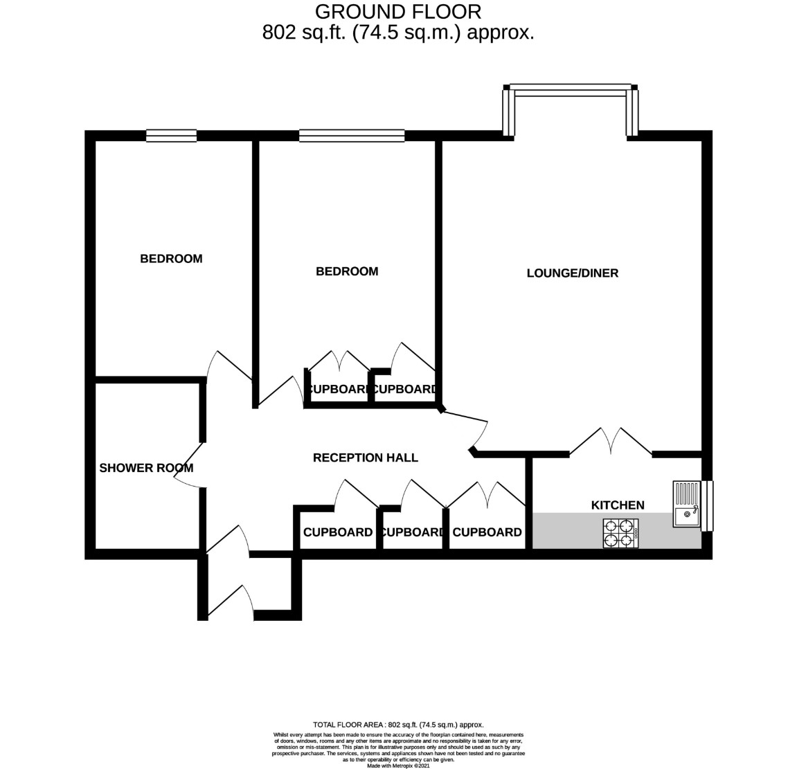
23 Exmouth Court, Long Causeway, Exmouth, Devon, EX8 1TB
THE ACCOMMODATION COMPRISES: Communal Entrance with door entry intercom system. The Apartment is located on the GROUND FLOOR and approached via own private front door with letterbox giving access to:
ENTRANCE LOBBY: With inner door leading to the:
RECEPTION HALL: With door entry phone; good sized coats cupboard with coat rack and housing the electric consumer units; further fitted shelved storage cupboard; spacious airing cupboard with slatted shelving and housing the water cylinder; night storage heater; coved ceiling.
LOUNGE/DINING ROOM: 15' 8" x 13' 0" (4.78m x 3.96m) maximum measurement into uPVC double glazed square bay window; feature fire surround housing electric coal effect fire; night storage heater; television point; telephone point; coved ceiling; glazed panelled double doors leading to the:
KITCHEN: 9' 10" x 6' 3" (3m x 1.91m) Fitted with a range of patterned work top surfaces with tiled surrounds; range of base cupboards, drawer units, integrated fridge and freezer beneath work tops; inset one and a half bowl single drainer sink unit with mixer tap over; inset four ring halogen hob with extractor hood over; built-in oven with cupboards above and below; matching range of wall units at eye-level with concealed lighting beneath; coved ceiling; electric plinth heater; uPVC double glazed window.
BEDROOM ONE: 13' 5" x 9' 8" (4.09m x 2.95m) maximum measurement into doorway recess. uPVC double glazed window; electric wall heater; built-in double wardrobe with clothes rail and shelf and adjoining shelved cupboard; coved ceiling; telephone point; wall mounted mirror-fronted cabinet
.
BEDROOM TWO: 11' 5" x 9' 0" (3.48m x 2.74m) uPVC double glazed window; electric wall heater; coved ceiling.
SHOWER ROOM/WC: Comprising of a double-width shower cubicle with shower unit, hand rail and sliding shower splash screen doors; wash hand basin set in display surface with fitted mirror and light/shaver socket over, cupboards beneath; WC with concealed cistern and display surface over; fully tiled walls; coved ceiling; electric wall heater; heated electric towel rail; extractor fan.
OUTSIDE: Exmouth Court enjoys attractive communal gardens with seating areas, there is also a PARKING AREA.
TENURE AND OUTGOINGS: The annual service charge for April 2024 is approx £3,071.81 and the annual ground rent is currently £200.
FLOOR PLAN:

